Slide 1

Final Capstone Project
Andy Tse, Andres Wagner, Xiaopeng Wang
Group 3
ALY 6980: Capstone
Dr. Matthew Goodwin

Slide 2

Introduction
Sponsor: Doc Digitizer
Group 3 Goal: Develop an Analysis and Visualization Interface for understanding the efficiency of Artificial Intelligence/ Machine Learning Algorithms

Slide 3
Andrés Wagner Individual Project Proposal
Individual Project Proposal:
Utilizing necessary data:
Actionable insights based on client data can be developed
Equip DocDigitizer with the tools to inform promotion or other marketing decisions.
How DocDigitizer can inform decisions utilizing dashboards that allow users to gather insight quickly and determine the most important components to successfully reach the appropriate consumers.

Slide 4
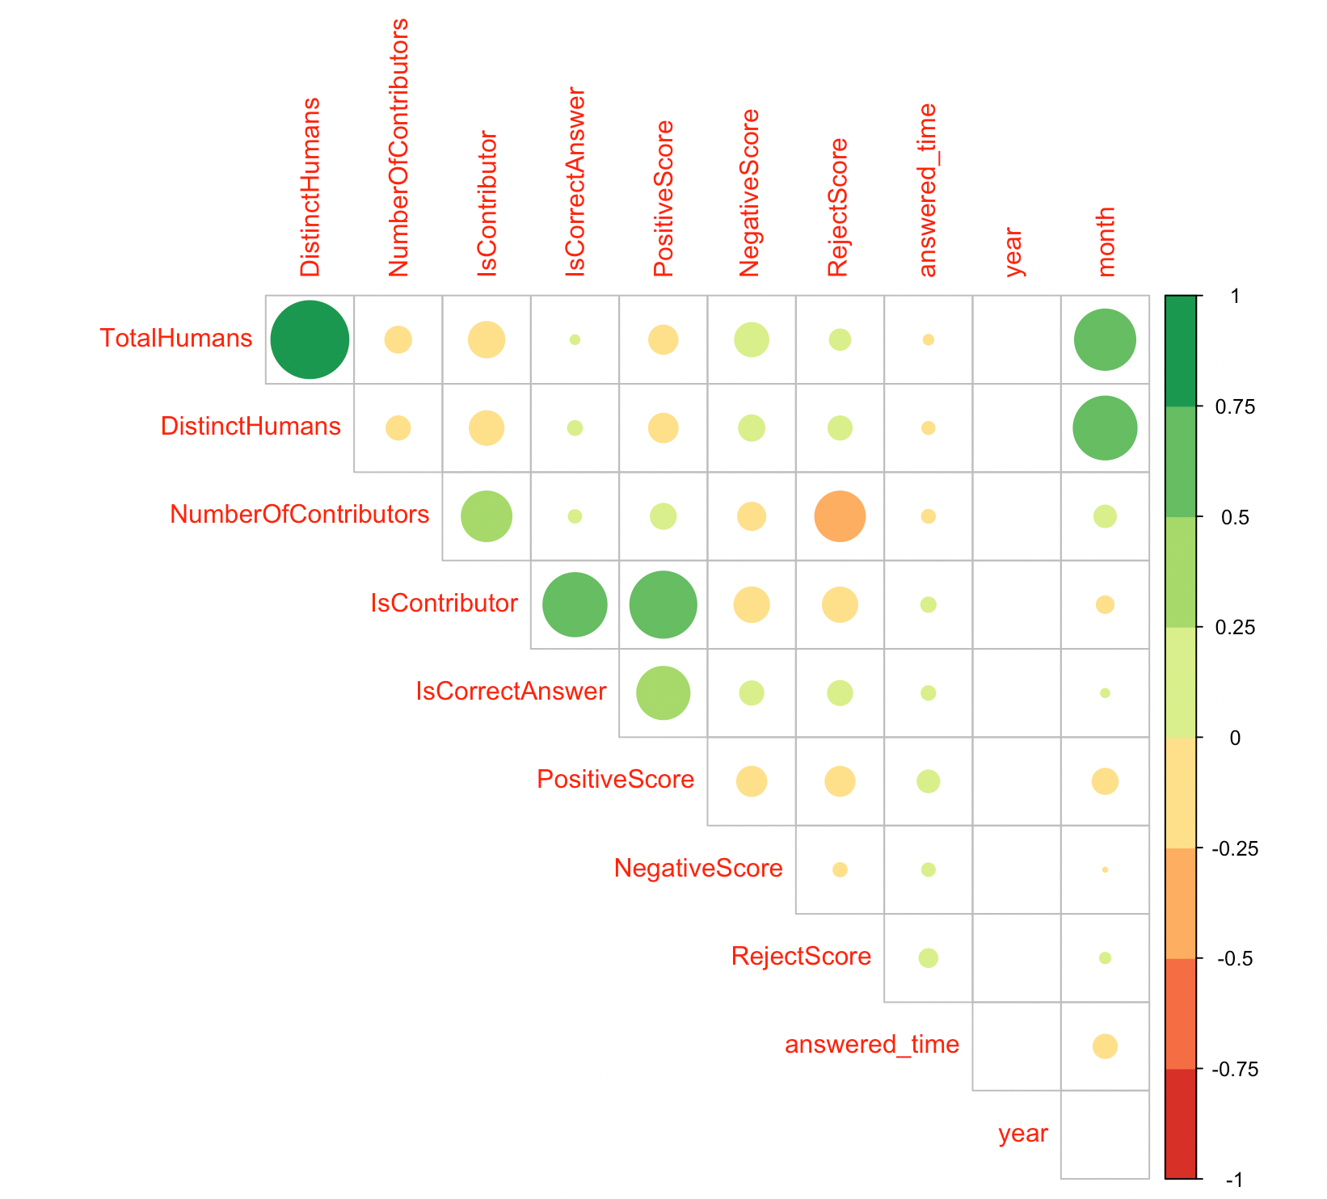
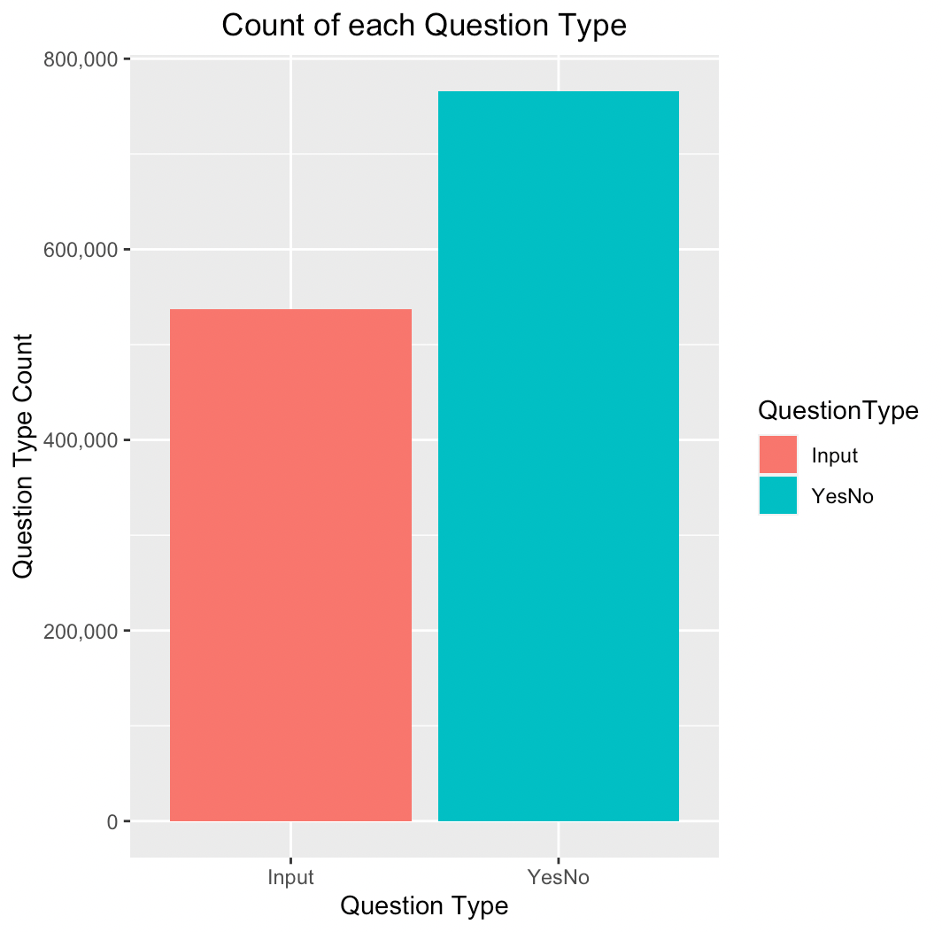
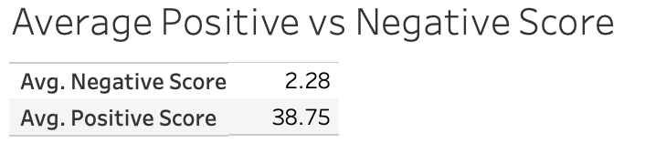
Andrés Wagner Group 3 Contribution
Group 3 Contribution:
Team Lead
Coordinate weekly meetings
Facilitate and create group documents
Exploratory Analysis
Preliminary Data Cleaning
Correlation Plots
Histograms
Box Plots
Measures of Central Tendency
Final Dashboard
Other Necessary Visualizations displaying crucial information to DocDigitizer

Slide 5
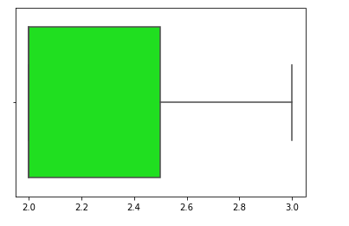
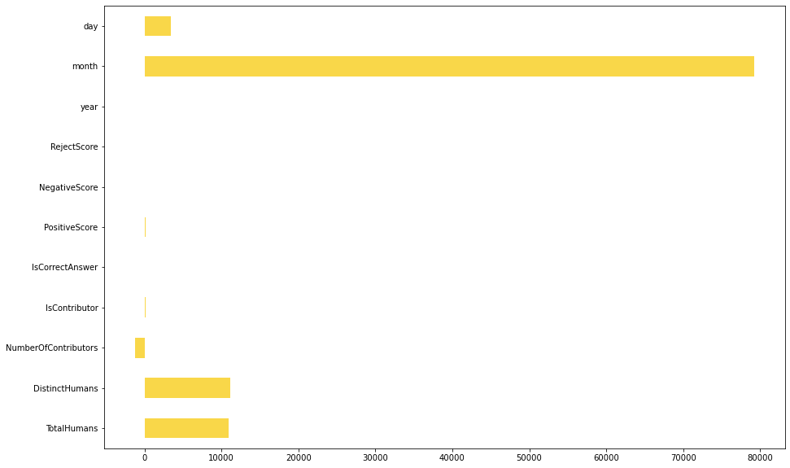
Andy's Project Proposal
The purpose of the project is to hire more people and to expand to other areas.
Such as building legal or accounting departments to establish the protection from legal and financial needs. An instance is to keep track of its spending on resources.
Limiting to only the functions doing NLP and cognitive processing signifies that there is more to be done such as using deep learning, machine learning, among others.
As the company grows and innovates with new technological tools, there is always a need to have more employees with additional skills to fulfill the sponsor's needs.
Expanding to potential locations is another key step to create a long-term goal of advancements in their products.

Slide 6
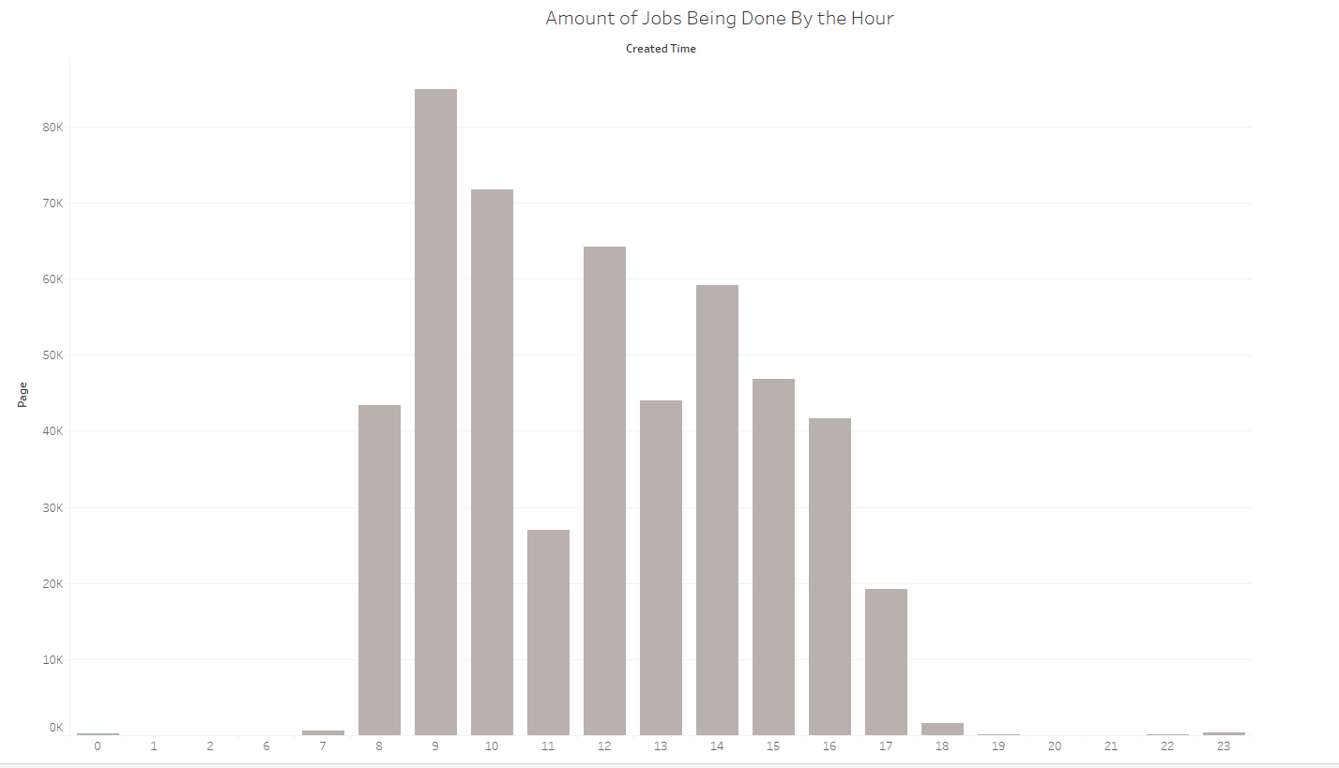
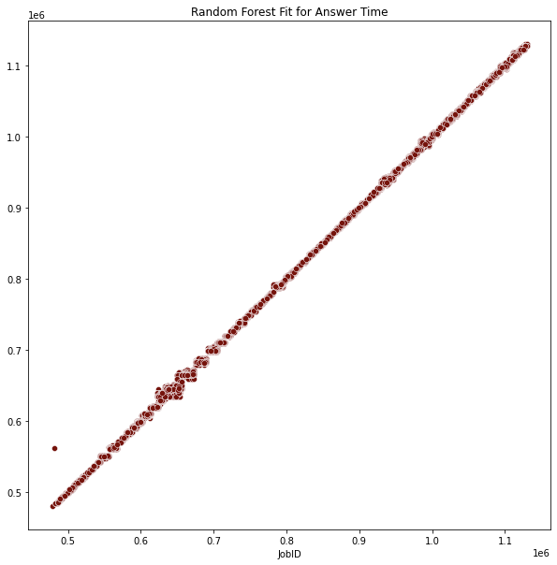
Andy's Contribution
Facilitated on implementing the data through Microsoft Azure and getting that part started.
Cleaned the datasets using Python to remove all the null values and outliers that still exist from the previous formats.
Implementing various statistical methods to find differences in the roles within the amount of contributors that are present.
Building histogram distributions on how much work activity is done by the hour and to evaluate about its hiring needs.
Identify which variable that is important for building a regression model and if it is related to time, the day will be evaluated on its activity.

Slide 7
Xiaopeng's Project Proposal
Select the data you want to use, observe which variables have little effect on the analysis and which are relevant to the analysis, and determine the type of variables.
Through the relationship between variables, make a model to observe the trend.
Through analysis, this paper puts forward some suggestions and marketing strategies to DocDigitizer
Whether the questions raised by agents have a positive impact on DocDigitizer and which agents are better.

Slide 8
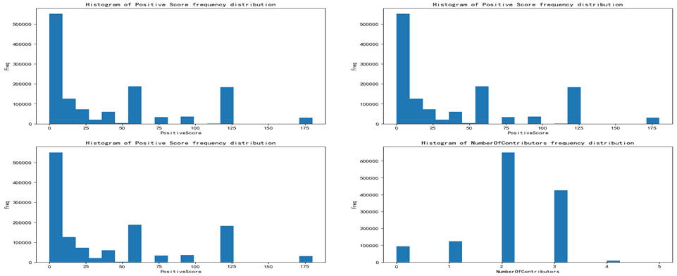
Xiaopeng's Contribution
Use Python to clean up data and delete variables with little correlation
Through EDA analysis and modeling, the count, mean, standard deviation, maximum and minimum values and quantiles of statistical variables are. The data characteristics of each variable can be well observed.
The frequency distribution histogram of specific variables and the results of positive score, negative score and rejection score of cleanagent data set. It can be seen from the results that the distribution of these three scores is not a general distribution, that is, it is not a normal distribution. From the results of scores, the distribution of scores is mostly low, and the scores do not show regularity.

Slide 9
References
Knaflic, C. N. (2015). Storytelling with data: A data visualization guide for business professionals. John Wiley & Sons.
Zaric, D. (2021, December 9). Better Heatmaps and Correlation Matrix Plots in Python. TowardDataScience. Retrieved February 26, 2022, from https://towardsdatascience.com/better-heatmaps-and-correlation-matrix-plots-in-python-41445d0f2bec

